Slide 1



Investment Grade
Gold
as a Viable Tool and Store of Value for Creating & Securing a Sustainable Affordable National Housing Program in Nigeria
www.dukiapreciousmetals.co

Slide 2



Presentation at the
TUNDE FAGBEMI
Chairman
Dukia Gold

Slide 3


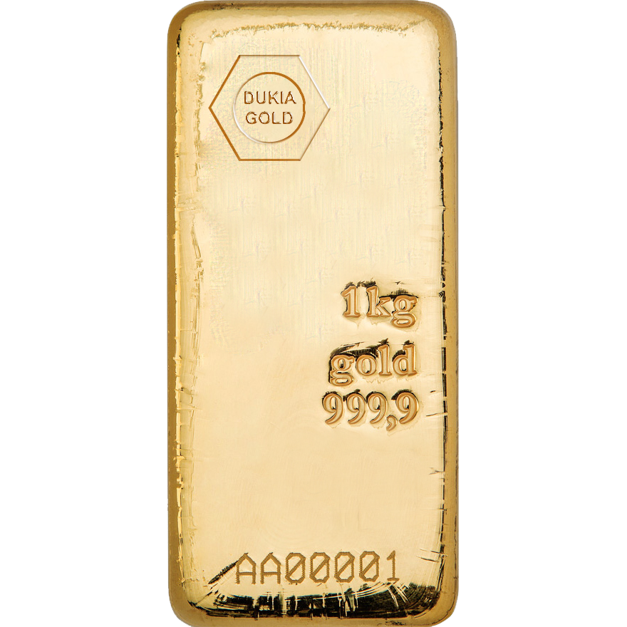
Dukia Gold
At this Summit we will talk about “INVESTING IN GOLD”
& DIVERSIFICATION OF THE NATIONAL HOUSING CASH BALANCE PORTFOLIO INTO GOLD AS AN INVESTMENT PRODUCT WHICH IS BEYOND THE TRADITIONAL ASSET CLASS
NOVEMBER 28, 2023

Slide 4
Dukia Gold Solutions for
Affordable National Housing Finance
Dukia Gold
At this National Housing Summit, we will talk about
Dukia Gold, your Precious Metals Refinery & trusted gold Bullion Merchant
Dukia Precious Metals Trading, an SBU of
Dukia Gold & Precious Metals Refining Co. Ltd.
November 2023
Strictly Private and Confidential

Slide 5
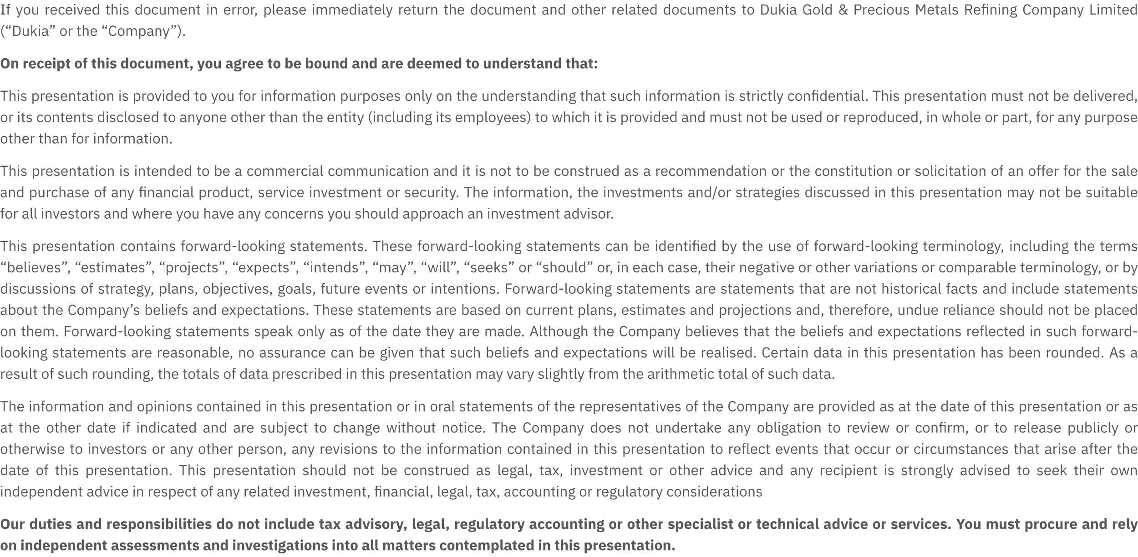

Slide 6
Introduction
Overview of Dukia Gold
Dukia Precious Metals Trading stands as the preeminent investment-grade precious metals trading company in West Africa, and holds its position as the region's premier bullion merchant. Our operations adhere to the highest industry standards, aligning with LBMA, WGC, IRMA, ESG, and OECD benchmarks.
Operating throughout the complete precious metals value chain, we bring value from the extraction phase in mines to the final market distribution. Within our Retail segment, our flagship product is the 1-gram pool-allocated gold, available for trade at 5000 naira. This exclusive offering caters to discerning customers through our sophisticated DPM E-commerce digital trading platform and an extensive network of distribution channels.
Furthermore, our Wholesale trading platform is designed to meet the needs of savvy investors, providing 1kg gold bullion bars and coins. This wholesale service operates under the regulatory approval of the SEC through a sanctioned Self-Regulatory Organization (SRO).

Slide 7
Purpose of the presentation
Introduction:
  Dukia Gold is honored to present at the 6th Nigeria Affordable Housing Finance and Innovation Summit & Expo (NAHFIS) 2023.
  Our objective is to introduce groundbreaking solutions that bridge the gap between traditional housing finance methods and cutting-edge investment strategies.
Addressing Housing Finance Challenges:
  Recognizing the challenges in the current housing finance landscape.
  Offering insights into how Dukia Gold's expertise in precious metals trading can revolutionize affordability and accessibility.
Innovation in Asset-Based Financing:
  Unveiling Dukia Gold's novel approach to housing finance.
  Emphasizing the strategic use of gold as an asset to empower potential homeowners and housing project contractors.

Slide 8
Challenges Facing the National Housing Project
Everyone in the Affordable Housing ecosystem recognizes that in addition to the several socio-economic issues, inconsistent public policy pronouncements, etc, the Affordable Housing programs and sustainable housing finance in Nigeria are also plagued by the following:
FX volatility - FX rates play a crucial role in international transactions. Fluctuations can impact the cost of imported materials, affecting overall project expenses in housing development.
Inflation - Inflation erodes the purchasing power of money over time. For our scenario, it can lead to an increase in the cost of goods and services related to housing development.
Interest rates - Interest rates influence borrowing costs and returns on investments. Changes can affect financing options, impacting the overall feasibility and profitability of housing projects.

Slide 9
The Big Question Facing the National Affordable Housing program
The big question is, can members of the National Integrated Social Housing program honestly finance and deliver a N25m or N50m or N100m housing project at a Fixed Price over a 24 months period in Nigeria, when the inflation rates keeps moving from below 20% to above 27%, when the US dollar exchange rate has moved from N460 to N800 to N1,185 within the space of 24 months and the interest rate is jumping from 11% to more than 25%, and the price of fuel, price of cements, price of sand, price of gravel, price of iron rod etc keeps increasing?

Slide 10
What Can the National Housing Industry do to Fight FX Volatility, Inflation and Interest Rate?
Convert THE NATIONAL HOUSING CASH BALANCE PORTFOLIO away from traditional asset class into investment-grade Gold products
The following slides will justify the reasons why the National Housing ecosystem must embrace Gold as a new investment and protective asset class.
We will review in the following slides low-risk asset class, medium-risk asset class, high-risk asset class, and we will also examine how the National Affordable Housing industry can diversify and protect their cash portfolio from inflation, FX volatility and interest rate.
We will examine some investment-grade Gold products offered by Dukia Gold.

Slide 11

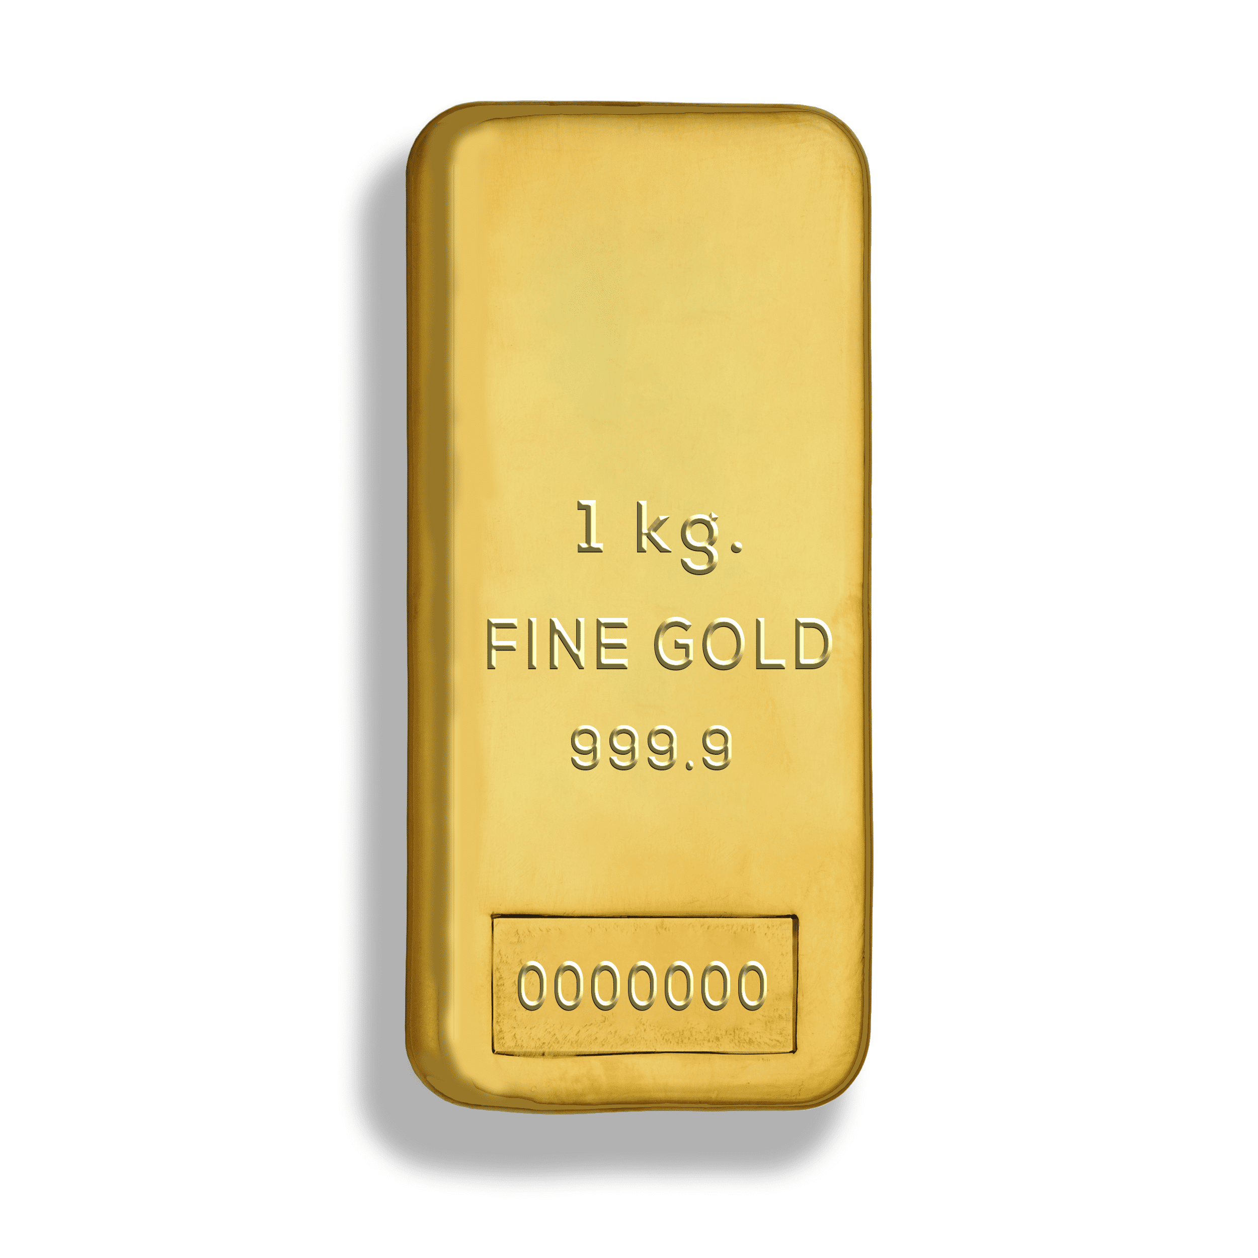
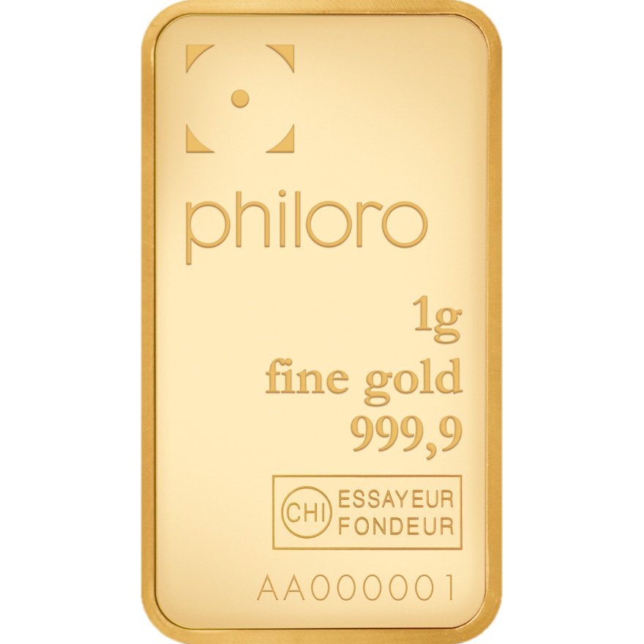
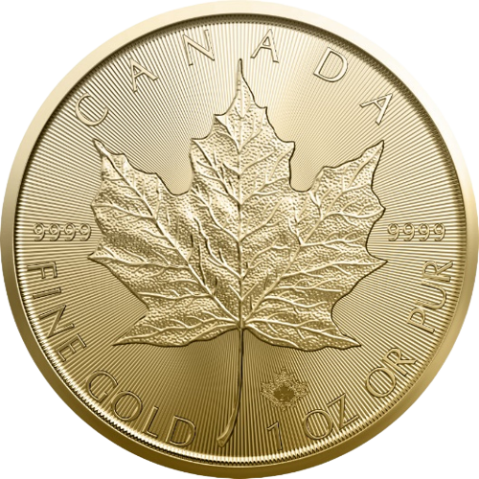
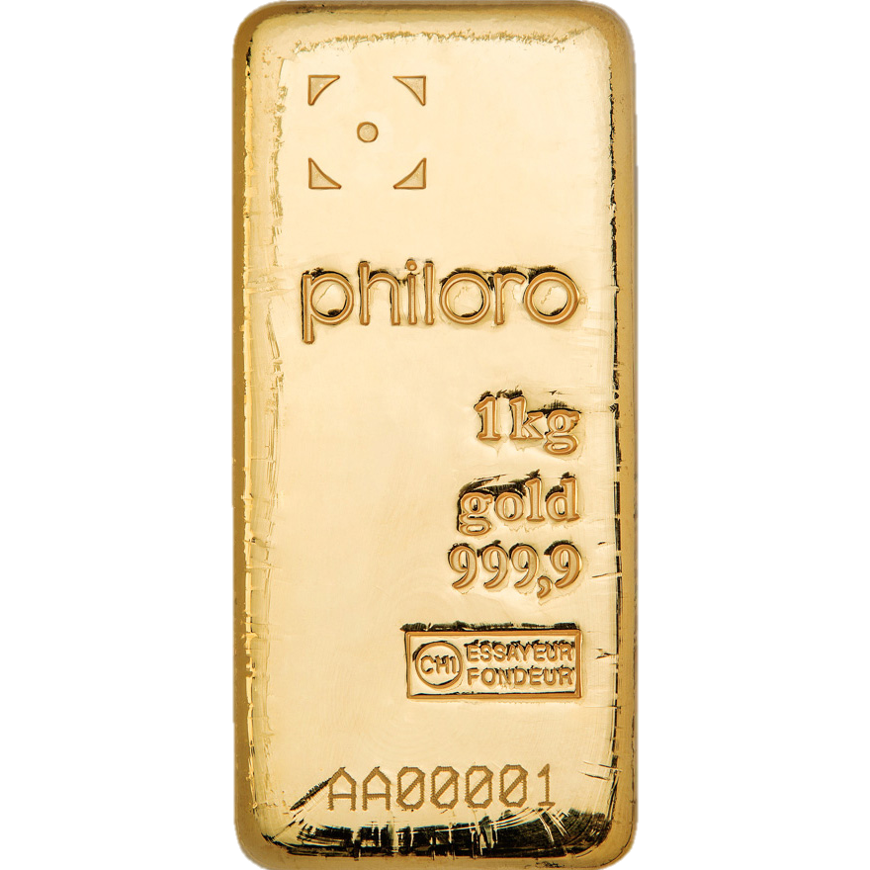
TOPIC:
LOW-RISK ASSET CLASSES
Protection against inflation and currency fluctuations
Liquidity when ready to purchase the property
Potential for increased value of gold investment over time

Slide 12
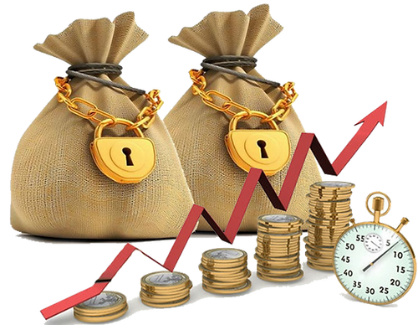
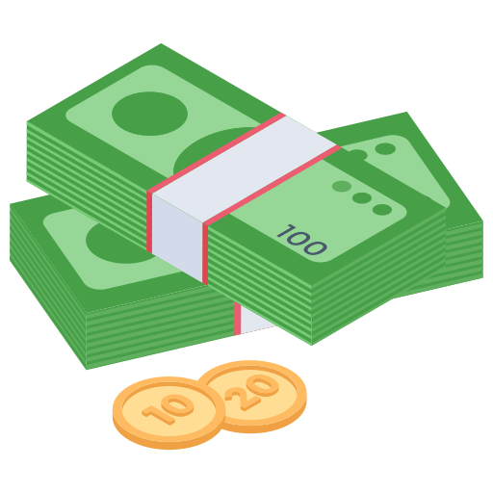
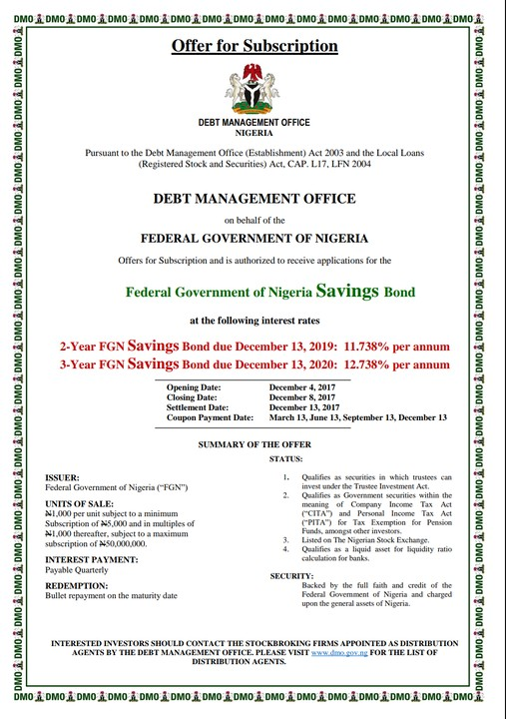

Low-Risk Asset Classes
Asset classes that have a lower level of risk compared to more volatile or speculative investments.
Preserves your capital
Limits your returns.
Notes:
Low-risk asset classes are investment options that are generally considered to have a lower level of risk compared to more volatile or speculative investments. These asset classes are often favored by conservative investors who prioritize capital preservation and are willing to accept potentially lower returns in exchange for a greater degree of safety.

Slide 13
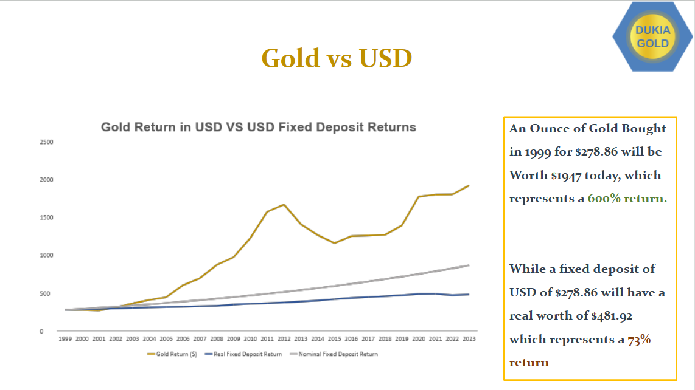

Slide 14
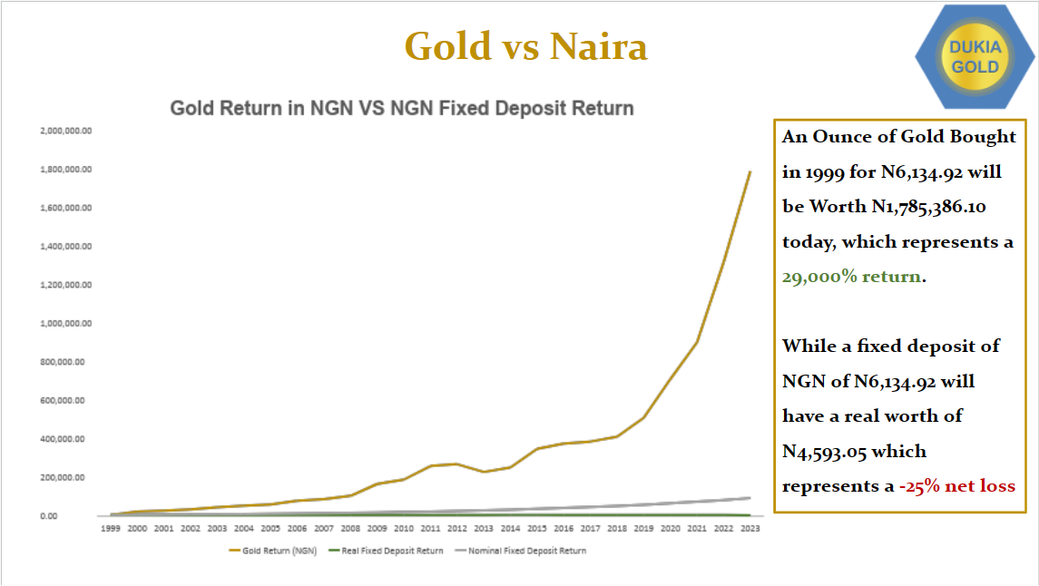

Slide 15

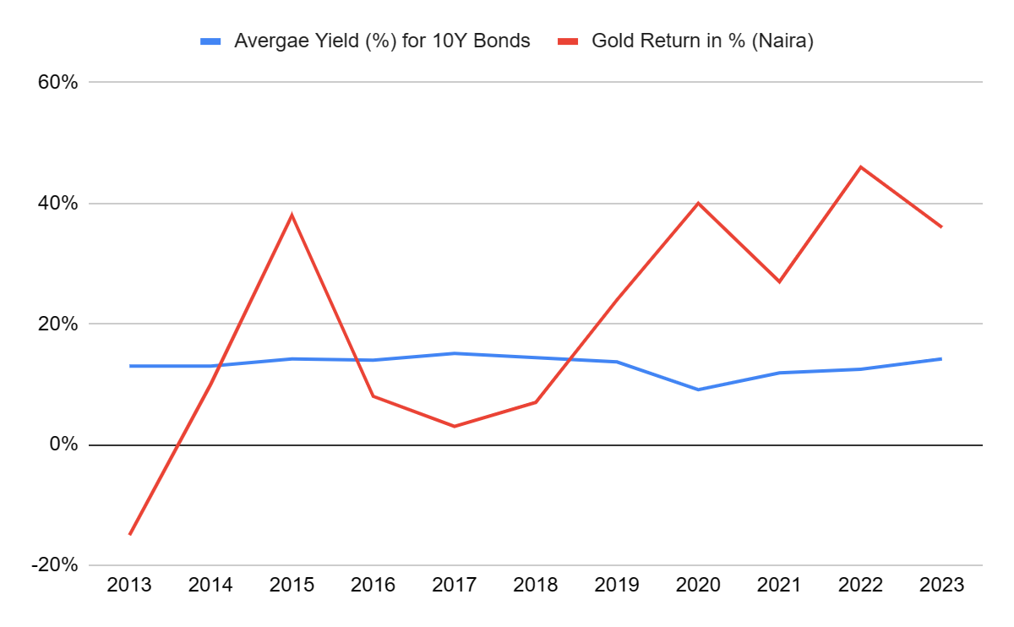
Gold vs Nigeria’s 10Y Government Bond
Gold Outperforms Average Yield (%) of the Nigeria’s 10Y Bonds.

Slide 16
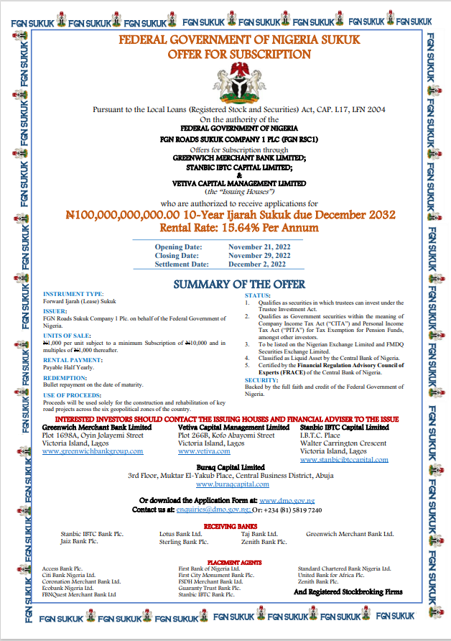
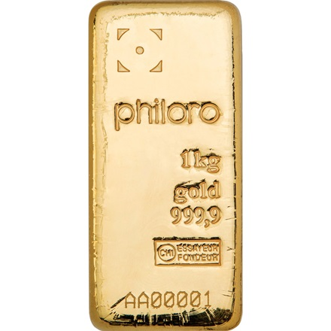
Sukuk Bonds vs Gold
Offer a fixed returns, return per year is 15.64%
Minimum subscription of N10,000
Sukuk are often used to raise capital for large-scale projects.
Offer a variable return, the 1st half of 2023, Gold had a return of 78.4%
Invest as low as N5000.
Gold is typically known as a store of value, a hedge against inflation and a safe haven asset during times of economic uncertainties.

Slide 17
TOPIC:
MEDIUM-RISK ASSET CLASSES

Slide 18
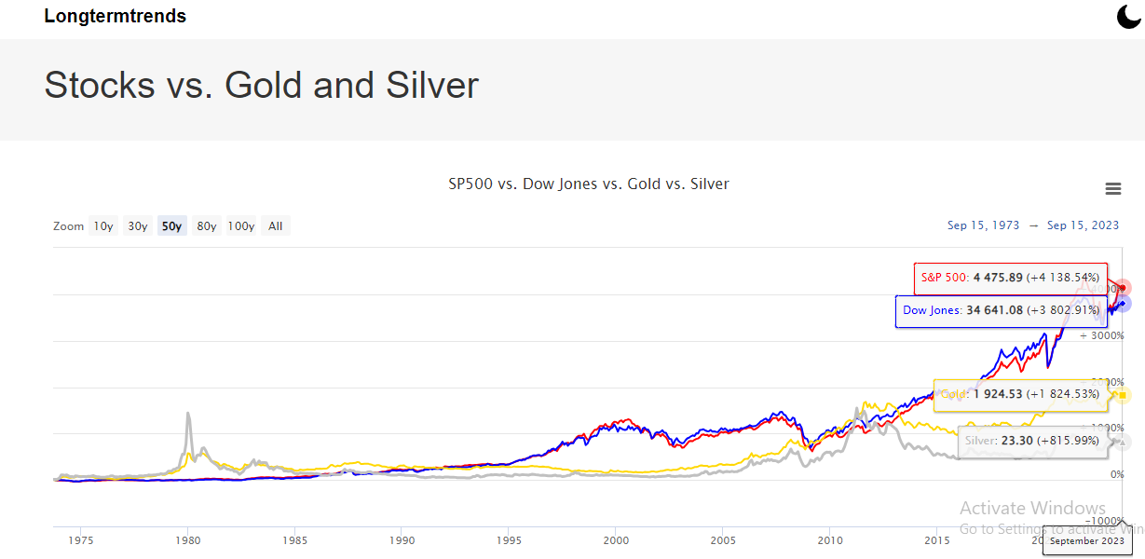
Gold as a portfolio diversifying component – No correlation with stocks
Diversification benefits
Volatility
Market Fluctuations
Long-term growth

Slide 19
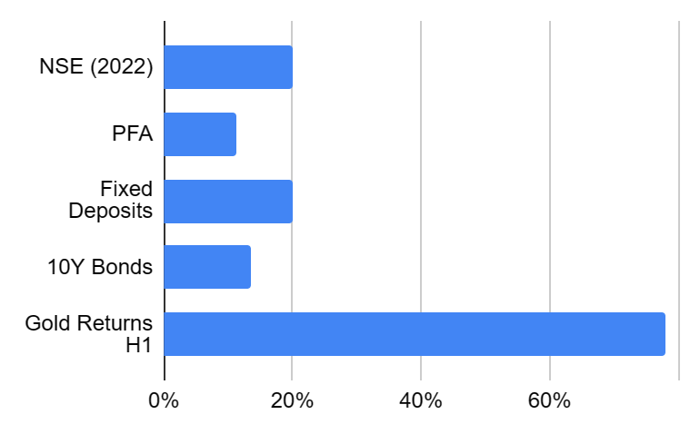
Using Real-World Investments (compare with inflation rate)
Investments | Nominal Interest rate % (rate of return) | Inflation rate % | Real Interest rate %
NSE(2022) | 19.98 | 24.08 | -4.10
PFA | 11.13 | 24.08 | -12.95
Fixed Deposit | 20 | 24.08 | -4.08
10Y Bonds | 13.63 | 24.08 | -10.45
Gold Returns H1 | 78.04 | 24.08 | 53.96

Slide 20
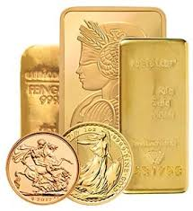

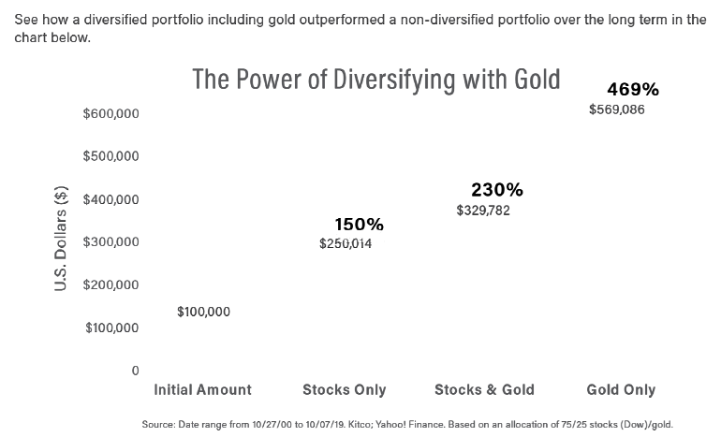

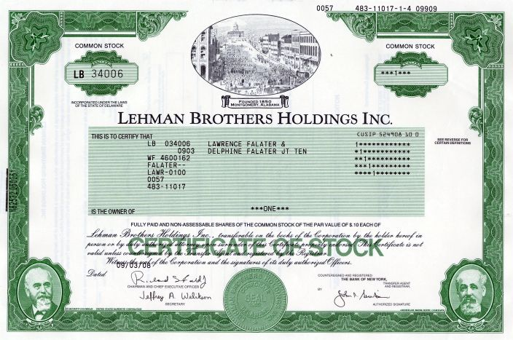
Gold as a portfolio diversifying component – No correlation with stocks
Investing in Investment Grade Gold.
Investing in Stocks

Slide 21
TOPIC:
HIGH-RISK ASSET CLASSES

Slide 22

Gold Vs Crypto
Gold
Gold is a physical asset. It comes in the form of coins, bars, or jewelry.
Gold has been used as a store of value for thousands of years. It has a long history of being a reliable asset.
Gold has various practical uses beyond investment, including in jewelry, electronics, and dentistry.
Bullion Gold markets are well-regulated, and there are strict rules governing its trade and storage.
Crypto
Cryptocurrency exists only in digital form and is stored in digital wallets.
Crypto is a relatively new asset class. It lacks the historical track record of gold.
Crypto primary utility is as a digital currency and a speculative investment.
Crypto regulatory environment varies by country and is less uniform. It operates in a decentralized fashion.
Key Differences

Slide 23
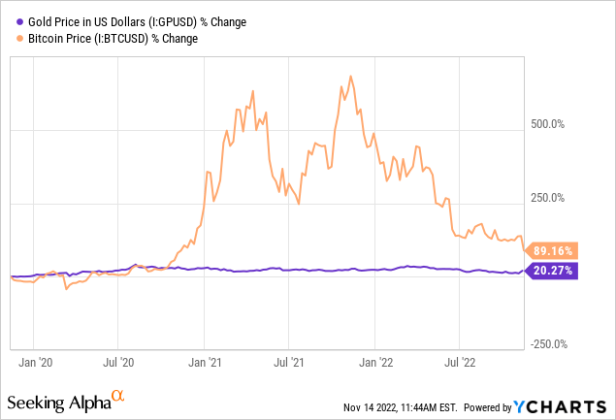
Gold vs Crypto Returns
With High Risk come High Returns
Or Losses

Slide 24
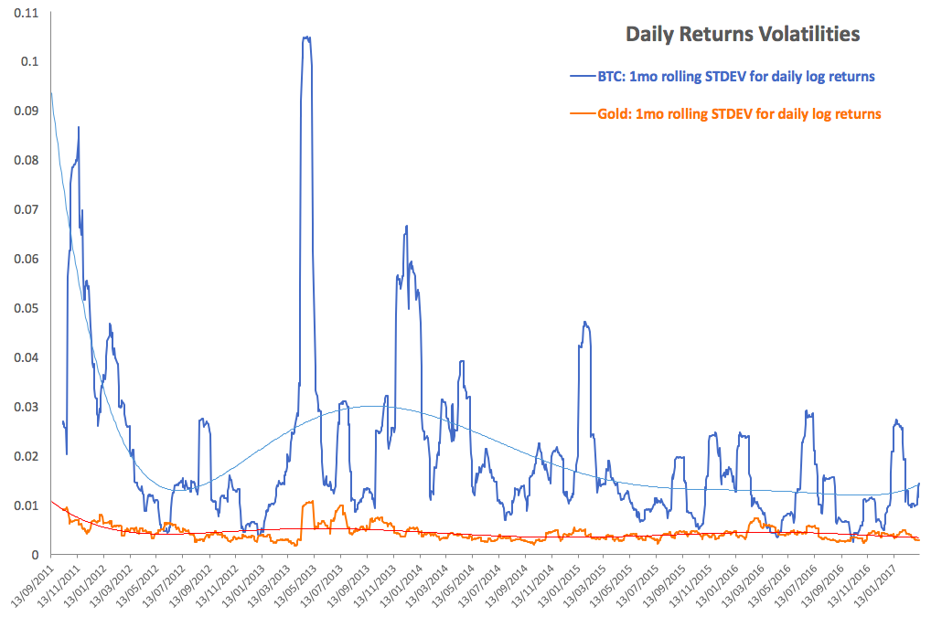
Volatility
Volatility chart of Gold Vs Bitcoin
Gold is very stable compared to Bitcoin
Gold has low correlation to Bitcoin

Slide 25
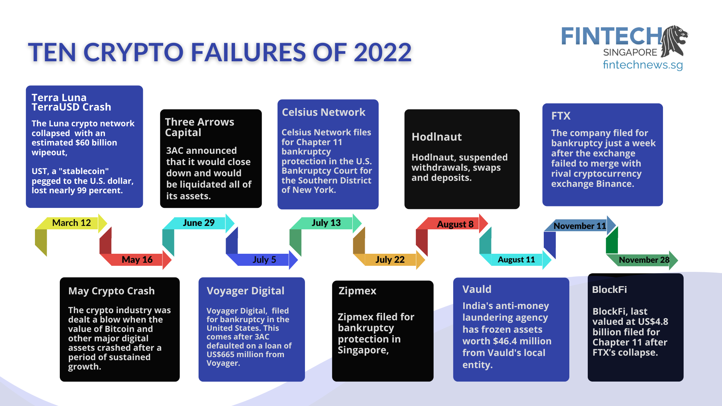

Counterparty Risks
Gold has no counterparty risks
But Crypto

Slide 26


Diversification
Diversification is the key
And Gold is a perfect asset

Slide 27
DIVERISIFYING YOUR
PORTFOLIO

Slide 28
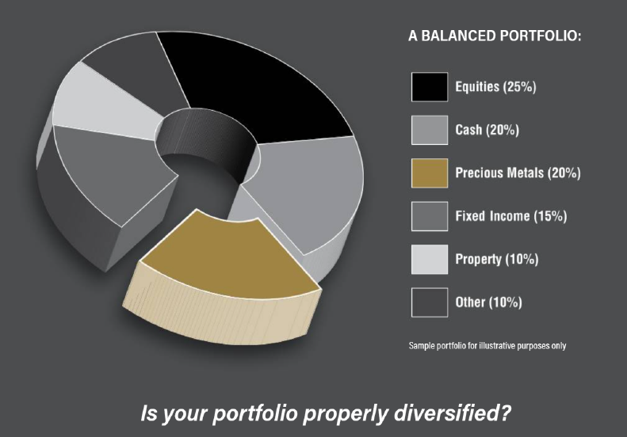
Balanced Portfolio
Invest
20 - 25%
in Precious Metals

Slide 29
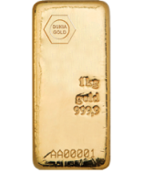

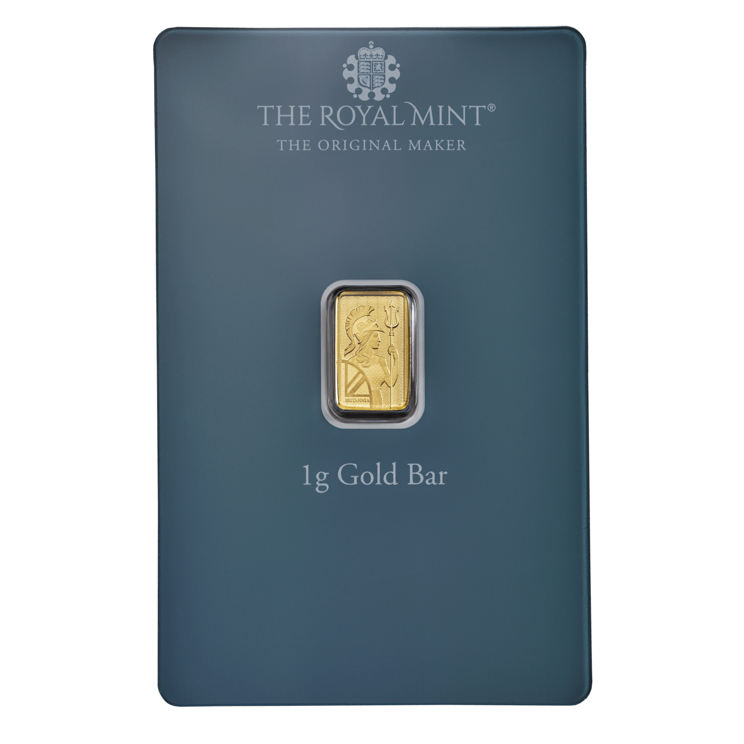

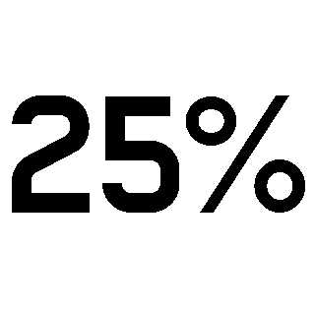
Dukia Gold Products
Deliverable gold bars and coins, of the highest purity in varying sizes and weights. Weights range from as low as 1g to as high as 1kg for bars and in ounces for coins for secure & insured storage and delivery
Managed gold products, We have the Pool Allocated Gold that allows investors to invest in vaulted gold based on monetary value from as low as N5,000.
Of your savings and the national housing cash balance portfolio

Slide 30
How to Get Started
1
2
3
4
Verification is complete!!!!
You can proceed to fund your account and purchase gold.
Confirm email address and fill the KYC form when you login to your account
Go to dukiapreciousmetals.co and click “Get Started”
Fill the necessary details and click “Create”

Slide 31
Solution: From the above discussions we can all agree that Gold is critical to financing a sustainable future of the National Affordable Housing program.
The National Affordable Housing program needs to urgently find and embrace investment-grade Gold products as a very resilient shield that will mitigate the effects of economic uncertainties on property development costs.
The National Affordable Housing program also needs to embrace gold as a very powerful tool and product that will enhance the sustainability of Affordable Housing finance in Nigeria.
The big question is how can Gold help?
How can investment-grade Gold help?
This presentation by Dukia Gold will show the National Housing Association how and why Gold-investment-grade Gold, is critical to financing and defending a sustainable future of the National Affordable Housing program.

Slide 32
Analyzing the Impact of Economic Factors such as FX Volatility, and Inflation on Property Investment
A Case Study: Financing constructing and delivering a cohort of Affordable Housing Project with N100m Over 30 months.
The scenario unfolds with a National Housing Contractor’s commitment to financing an affordable housing project, and advertising that the intending the buyer(s) will pay a total of N100 million for the unit(s) of affordable house(s) over a period spanning from January 1, 2021, to June 1, 2023. The payment structure involves the buyer(s) making four(4) instalmentall payments at specific intervals:
Month 0 (January 1, 2021): The buyer(s) initiates the project by depositing 30% of the total amount.
Month 15 (April 1, 2022): Another instalment of 40% is paid.
Month 24 (January 1, 2023): A further 20% instalment is due.
Month 30 (June 1, 2023): The final 10% instalment is paid.

Slide 33
The Cost Breakdown of the project – The inherent volatility and uncertainties in the construction industry
As at January 1 2021, the National Housing contractor expects to spend approximately N90 million as the cost of bought-in goods and services: This includes essential materials like cement (limestone), iron ore (steel), glass (silicon sand), sand, etc.
The contractor, as at January 2021 therefore expects a gross margin of 10% ,i.e N10m on the N100m project, provided, of course, that all things in the economy will be constant.
The challenge, however, comes from the fact that inflation, exchange rate devaluation, and several other uncertainties will materially dislodge the projection and all these will certainly result in an increased building cost over the period. This negative impact will affect the builder and the buyer.
The builder faces the risk of rising costs for materials, while the buyer faces the prospect of having to pay more than initially anticipated cost of acquisition using a weaker currency given the impact of inflation, devaluation of the currency, rising inflation.
The only solution for both the builder and the buyer is to have considered Gold-investment-grade Gold, as an alternate asset class to store their liquid cash while the building was in progress.
This scenario highlights the inherent volatility and uncertainties in the construction industry and underscores the need for strategies to mitigate risks, such as exploring the role of alternative assets like gold in preserving value and managing economic uncertainties.

Slide 34
Effects of Inflation and FX Volatility on Investment Options
Traditionally the investors in National Housing project, buyers and contractors have stored their Naira in asset classes such as:
Cash at Hand, Cash in Bank – current account, Cash in Bank –Savings Account, Cash in Bank – Fixed Deposit.
Investment in Corporate Bonds, Investment in FGN Bonds - issued by Federal or State Government
Investment in Stocks. i.e share capital of bluechip companies listed on the NGX
Investment in Commodities i.e deliverable stocks of iron rods, cements and other commodities required to complete the housing project.
All the above investment opportunities have been affected negatively by rising interest rate environment. For instance, bond prices tend to fall when interest rates rises. This can affect the value of existing bonds in the buyer’s investment portfolio.
Stocks can be influenced by changes in inflation and interest rates. Inflation can impact corporate earnings, and rising interest rates may affect the present value of future cash flows, influencing stock prices.
Fixed deposits are directly affected by interest rates. Higher interest rates can lead to better returns on fixed deposits, but existing fixed-rate deposits may lose value in a rising rate environment.

Slide 35
Impact of Inflation and FX Volatility on a N100m Property Development Cost
Period | Inflation | Interest | FX Official ($/₦) | FX Black Market ($/₦) | Adjust for Interest Rate | Adjust for inflation | GOLD
Month 0: Jan, 2021 ₦30m deposit | 16.47 | 11.50% | 379 | 475 | Pay: ₦30m Balance: ₦70m | Pay: ₦30m Buyer keeps the ₦70m balance in his current account | Pay ₦30m for the house Use the balance to buy ₦70m worth of investment-grade Gold i.e 79.2862 ounces of Gold
Month 15: Apr, 2022 ₦40m installment | 16.82 | 11.50% | 415.22 | 587 | Invest the balance of N70m in a fixed deposit at 11.5% p.a. for 15 months. This will result in earned Interest + principal of N80,062,500 Pay: ₦40m Balance: ₦40, 062, 500 | At next installment the contractor adjusts the price of the project for inflation by 16.47%. Takes the price up by ₦14.4m New pay expected: ₦40m + ₦14.4m = ₦54.4m The buyer pays from the N70m in his current account. He is now left with a balance of ₦15.6m in his current account | Sell out of the ounces of Gold that you possess. ₦40m worth of investment-grade Gold of 36.1778 ounces. Keep the balance of 43.1084 oz (₦49m)
Month 24: Jan, 2023 ₦20m installment | 21.82 | 17.50% | 449.55 | 747.50 | Invest the balance of N40,062,500 in a fixed deposit at 11.5% p.a for 9 months. This will result in earned interest + principal of N43,517,890.625 Pay: ₦20m Balance: ₦23517890 | Next payment is due and adjusted for inflation at 16.82% . The new installment to pay is N20m + ₦1.97m = N21.97m The balance in his current account is N15.6m. Therefor he needs to look for a new amount of ₦6.4m | Raise ₦20m by selling 13.333 ounces worth of Gold. Keep the balance: 29.7751 oz (₦44.7m)
Month 30: Jun, 2023 ₦10m installment | 22.79 | 18.50% | 461.18 | 768 | Invest the balance of N23,517,890 ina fixed deposit at 17.5% p.a for 6 months. Earn interest + principal N25575705.375 Pay: ₦10m Balance: ₦15,575,705 (assuming all remains the same) | Next payment is due and adjusted for inflation at 17.5%. The new installment to pay is N10,875,000 Therefore, he owes N17,275,000 | Raise ₦10m by selling 6.7824 ounces of Gold. Keep the balance: 22.9933 (₦33.9m)

Slide 36
Gold is a Shield on the Effects of Inflation and FX Volatility on Affordable Housing Finance
From the explanation on the N100m Housing project it’s obvious that the only asset class that shielded everybody from inflation and FX volatility is Gold. Valued for its intrinsic worth, gold acts as a robust shield, offering a safe haven in economic uncertainties and providing a protective layer against unpredictable shifts.
Period | Inflation | Interest | FX Official ($/₦) | FX Black Market ($/₦) | Gold (per ounce -oz)
Month 0: Jan, 2021 ₦30m deposit | 16.47 | 11.50% | 379 | 475 | $1,858.69 | Pay: ₦30m Buy: ₦70m gold for 79.2862 oz
Month 15: Apr, 2022 ₦40m installment | 16.82 | 11.50% | 415.22 | 587 | $1,883.56 | Sell ₦40m gold for 36.1778 oz Balance: 43.1084 oz (₦49m)
Month 24: Jan, 2023 ₦20m installment | 21.82 | 17.50% | 449.55 | 747.50 | $1,953.14 | Sell ₦20m gold for 13.333 oz Balance: 29.7751 oz (₦44.7m)
Month 30: Jun, 2023 ₦10m installment | 22.79 | 18.50% | 461.18 | 768 | $1,919.80 | Sell ₦10m gold for 6.7824 oz Balance: 22.9933 (₦33.9m)

Slide 37
Conclusion – Gold is a Strategic Tool in Ensuring Affordable Housing Finance in Nigeria
By strategically incorporating Gold into the housing purchase investment strategy, the buyer not only bolsters their financial resilience but gains a powerful tool to navigate economic uncertainties with enhanced effectiveness.
We have shown that a house that was due to be delivered at N100m because of inflation will be delivered at a cost in excess of N117,245,000.
We have also shown that if the buyer took a loan of a N100m and kept the balance after the first installment in a fixed deposit account he will have a accrued for himself a total of N 15,575,705 as interest. But he will still needed to have paid N117,245,000 if the seller adjusted for inflation. Therefore he will had needed to look for at least N2m to balance up at the end of the 30 months transaction.
The only transaction that made sense of the 3 scenarios presented was the buyer that put the N70m balance from his loan into Gold and simply managed his portfolio by selling the right quantity of Gold at the right time. Even if we needed to adjust for inflation he had N33m in Gold and would still have been able to pay the additional price of N17.245m and still have over N15m left to buy furniture fittings and equipment.
Gold is a critical strategic tool in ensuring affordable housing finance in Nigeria. Builders, buyers, contractors needs tobe informed and educated on the need to diversify their portfolio while constructing a house or while buying a house with Gold holdings. This will ensure a robust and adaptable foundation for success in affordable housing finance in Nigeria.

Slide 38
Dukia Gold’s Proposal
Our proposition suggests that prospective clients of the affordable housing scheme establish a reserved account with Dukia Gold. This account is intended for financing the acquisition of an affordable home through the incremental purchase of gold from Dukia Gold until a sufficient accumulation is achieved to facilitate the purchase of a property from NAHFIS.
Dukia Gold is presenting a pioneering approach to housing finance by recommending that clients consider investing in gold as opposed to exclusive reliance on traditional savings and investment plans. This recommendation is grounded in the understanding that acquiring gold can serve as a strategic hedge against the impacts of domestic inflation and foreign exchange challenges.

Slide 39

Benefits of Dukia Gold's Solution
N 40,000,000
N 53,932,000
A house valued at Fourty Million Naira at the beginning of the year
The house will be valued at about Fifty Million, Nine Hundred and Thirty Two Thousand Naira today
N 50,000,000
N 50,000,000
Fifty million naira cash at bank and cash in hand at the beginning of the year
Remains Fifty million naira cash at bank and cash in hand as at today
N 50,000,000
N 98,000,000
If you acquired a gold bar for Fifty Million Naira at the beginning of the year
The gold will be valued at about Ninety Eight Million Naira today
Employing a practical illustration, consider a prospective housing client associated with NAHFIS who possessed 50 million naira in cash at the commencement of the year, intending to procure a property valued at 60 million naira presently. Had the individual retained the cash, the property acquisition would remain unattainable. Conversely, by opting to invest the 50 million naira in gold, the appreciable gains in both gold valuation and foreign exchange rates would facilitate the client's ability to realize the property acquisition.

Slide 40
Conclusion
In closing, Dukia Gold is honored to have shared our vision for reshaping the landscape of affordable housing finance at the 6th Nigeria Affordable Housing Finance and Innovation Summit & Expo (NAHFIS) 2023. Our commitment to innovation, financial inclusion, and resilience in the face of economic challenges propels us forward.
As we navigate the evolving terrain of affordable housing, we extend an invitation for collaboration with NAHFIS. Together, we can usher in a new era of housing finance that combines the stability of precious metals with the dynamism required for sustainable community development.
In the spirit of partnership, we anticipate not only revolutionizing how we approach affordable housing but also creating lasting impacts on the lives of individuals and communities. Dukia Gold looks forward to the prospect of working hand-in-hand with NAHFIS to transform aspirations into tangible realities and, in doing so, contributing to a future where affordable housing is accessible to all.
Thank you for your attention, and we are eager to engage in further discussions to turn these aspirations into actionable strategies for the betterment of our communities and the advancement of the affordable housing sector in Nigeria.

Slide 41
CONCLUSION
We have shown the National Housing Association that there is need to diversify the cash holding portfolio of the buyer, the contractor and other National Housing ecosystem members.
Dukia Gold strongly suggests that the National Housing buyers, the contractors who provide the housing and the financiers needs to diversify their portfolio with assets that are not correlated.
Investment-grade Gold has proven to be one of the least correlated asset amongst all the traditional asset classes. And is thus a recommended tool for managing the effect of inflation, FX volatility and interest rate hikes that is impacting the delivery of affordable National Housing project.

Slide 42


Q&A

Slide 43
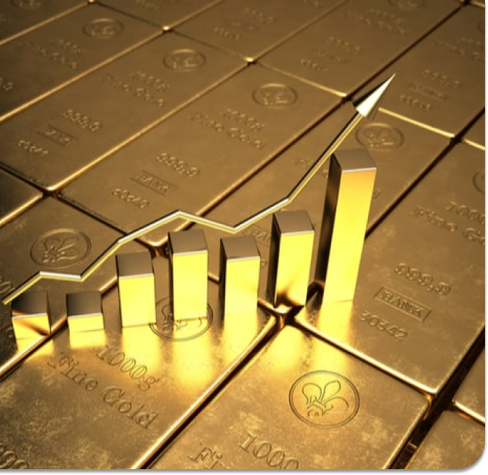


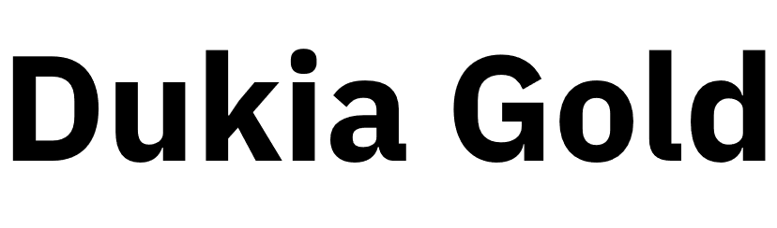

www.dukiapreciousmetals.co
+234 906 490 6311
+234 703 323 8121
+234 704 234 4640
+234 906 389 7908

